Slide 1
Chapter V – Linear Regression

Slide 2
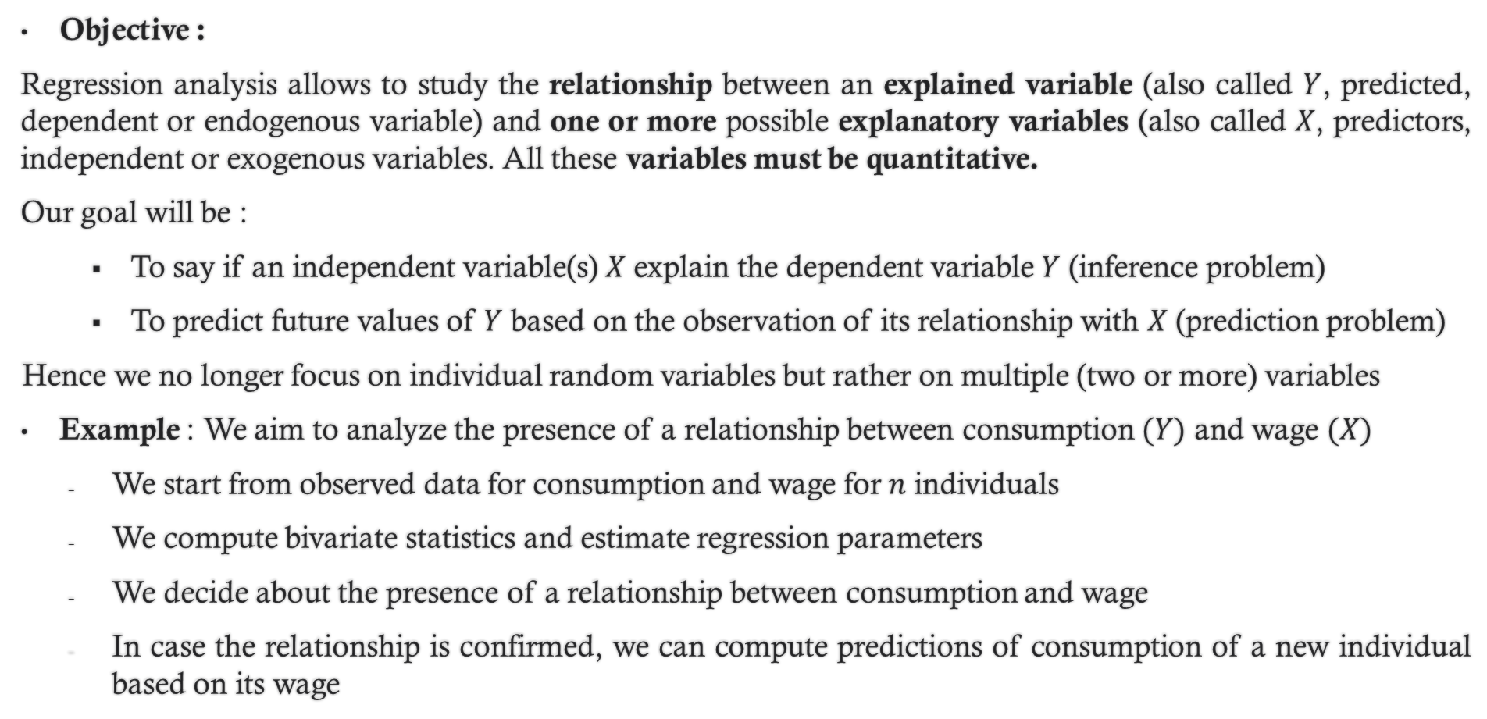
1. Introduction
Objective :
Regression analysis allows to study the relationship between an explained variable (also called $Y$, predicted, dependent or endogenous variable) and one or more possible explanatory variables (also called $X$, predictors, independent or exogenous variables. All these variables must be quantitative.
Our goal will be :
To say if an independent variable(s) $X$ explain the dependent variable $Y$ (inference problem)
To predict future values of $Y$ based on the observation of its relationship with $X$ (prediction problem)
Hence we no longer focus on individual random variables but rather on multiple (two or more) variables
Example : We aim to analyze the presence of a relationship between consumption $(Y)$ and wage $(X)$
We start from observed data for consumption and wage for $n$ individuals
We compute bivariate statistics and estimate regression parameters
We decide about the presence of a relationship between consumption and wage
In case the relationship is confirmed, we can compute predictions of consumption of a new individual based on its wage

Slide 3
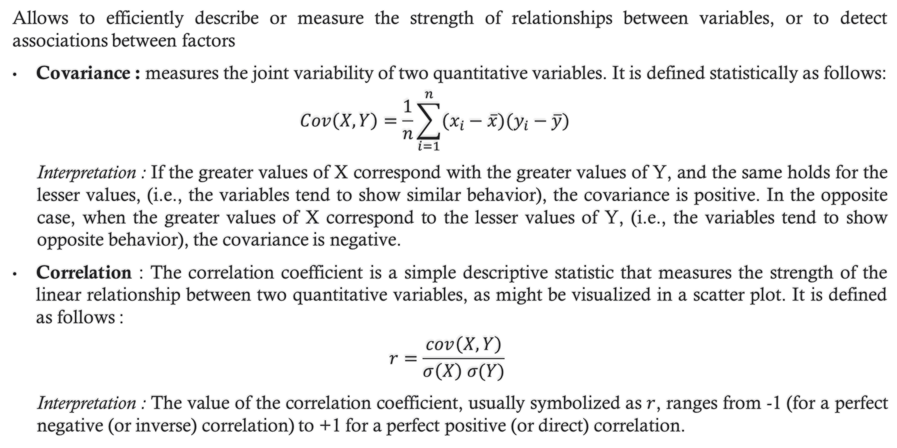
2. Bivariate descriptive statistics
Allows to efficiently describe or measure the strength of relationships between variables, or to detect associations between factors
Covariance : measures the joint variability of two quantitative variables. It is defined statistically as follows:
$$Cov\left(X,Y\right)=\frac{1}{n}\sum_{i=1}^{n}{(x_{i}−\overline{x})(y_{i}−\overline{y})}$$
Interpretation : If the greater values of X correspond with the greater values of Y, and the same holds for the lesser values, (i.e., the variables tend to show similar behavior), the covariance is positive. In the opposite case, when the greater values of X correspond to the lesser values of Y, (i.e., the variables tend to show opposite behavior), the covariance is negative.
Correlation : The correlation coefficient is a simple descriptive statistic that measures the strength of the linear relationship between two quantitative variables, as might be visualized in a scatter plot. It is defined as follows :
$$r=\frac{cov\left(X,Y\right)}{σ\left(X\right) σ(Y)}$$
Interpretation : The value of the correlation coefficient, usually symbolized as $r$, ranges from -1 (for a perfect negative (or inverse) correlation) to +1 for a perfect positive (or direct) correlation.

Slide 4
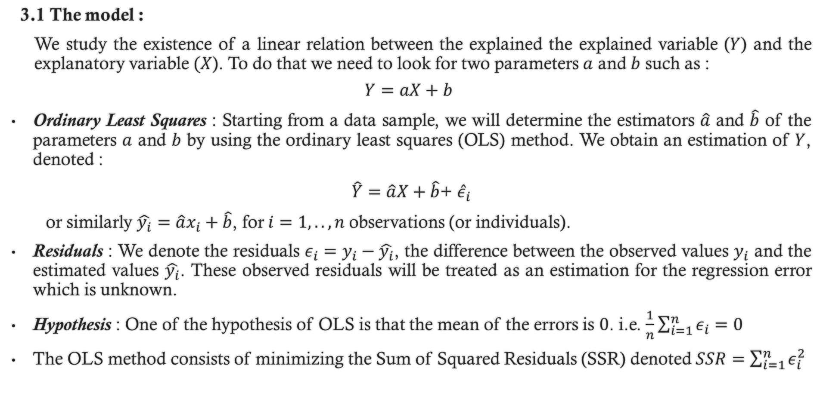
3. Simple linear regression
3.1 The model :
We study the existence of a linear relation between the explained the explained variable ($Y$) and the explanatory variable $(X$). To do that we need to look for two parameters $a$ and $b$ such as :
$$Y=aX+b$$
Ordinary Least Squares : Starting from a data sample, we will determine the estimators $\hat{a}$ and $\hat{b}$ of the parameters $a$ and $b$ by using the ordinary least squares (OLS) method. We obtain an estimation of $Y$, denoted :
$\hat{Y}=\hat{a}X+\hat{b}$+ ${\hat{ε}}_{i}$
or similarly $\hat{y_{i}}=\hat{a}x_{i}+\hat{b}$, for $i=1,..,n$observations (or individuals).
Residuals : We denote the residuals $ε_{i}=y_{i}−\hat{y_{i}}$, the difference between the observed values $y_{i}$ and the estimated values $\hat{y_{i}}$. These observed residuals will be treated as an estimation for the regression error which is unknown.
Hypothesis : One of the hypothesis of OLS is that the mean of the errors is $0$. i.e. $\frac{1}{n}\sum_{i=1}^{n}{ε_{i}}=0$
The OLS method consists of minimizing the Sum of Squared Residuals (SSR) denoted $SSR=\sum_{i=1}^{n}{ε_{i}^{2}}$

Slide 5

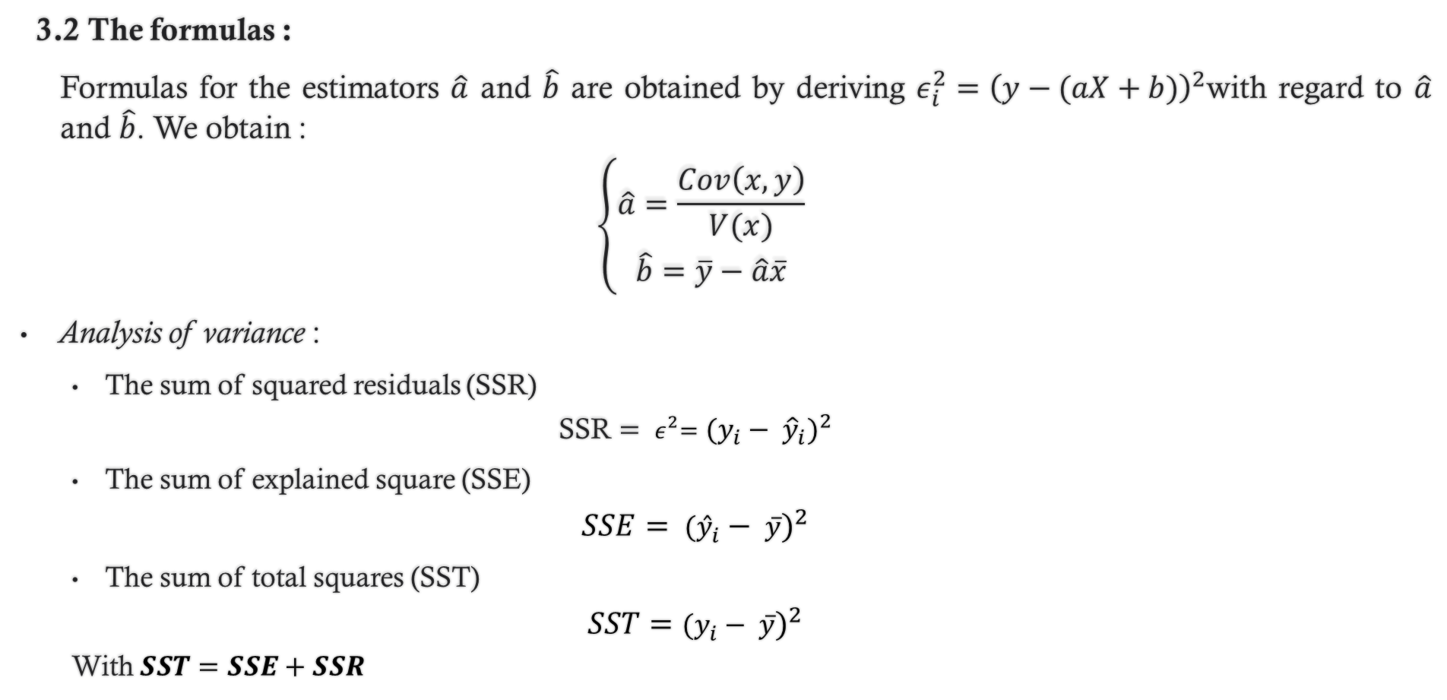
3. Simple linear regression
3.2 The formulas :
Formulas for the estimators $\hat{a}$ and $\hat{b}$ are obtained by deriving $ε_{i}^{2}={\left(y−(aX+b)\right)}^{2}$with regard to $\hat{a}$ and $\hat{b}$. We obtain :
$$\left\{\begin{aligned}\hat{a}=\frac{Cov\left(x,y\right)}{V(x)} \\ \hat{b}=\overline{y}−\hat{a}\overline{x}\end{aligned}\right.$$
Analysis of variance :
The sum of squared residuals (SSR)
$$\text{SSR}={{ ε}^{2}=(y_{i}− {\hat{y}}_{i})}^{2}$$
The sum of explained square (SSE)
$$SSE= {({\hat{y}}_{i}− \overline{y})}^{2}$$
The sum of total squares (SST)
$$SST={(y_{i}− \overline{y})}^{2}$$
With $SST=SSE+SSR$
Coefficient of determination R²:
Determines the part of variance that is explained by the model
$$R^{2}=\frac{SSE}{SST}$$

Slide 6
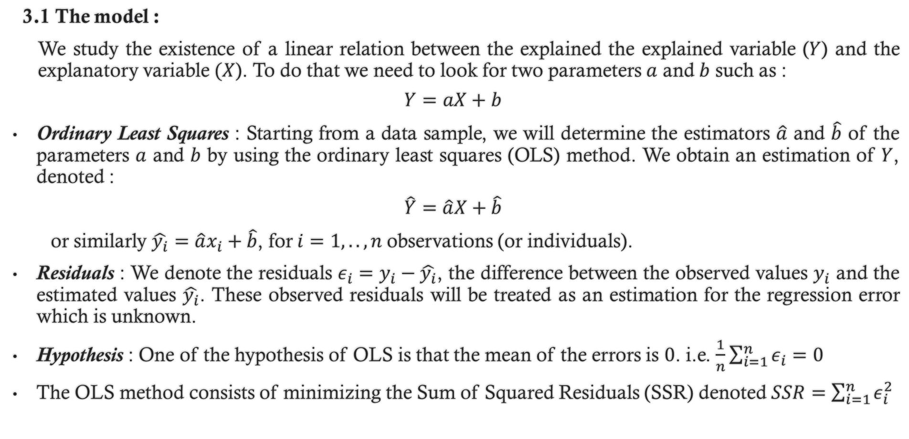
3. Simple linear regression
3.1 The model :
We study the existence of a linear relation between the explained the explained variable ($Y$) and the explanatory variable $(X$). To do that we need to look for two parameters $a$ and $b$ such as :
$$Y=aX+b$$
Ordinary Least Squares : Starting from a data sample, we will determine the estimators $\hat{a}$ and $\hat{b}$ of the parameters $a$ and $b$ by using the ordinary least squares (OLS) method. We obtain an estimation of $Y$, denoted :
$$\hat{Y}=\hat{a}X+\hat{b}$$
or similarly $\hat{y_{i}}=\hat{a}x_{i}+\hat{b}$, for $i=1,..,n$observations (or individuals).
Residuals : We denote the residuals $ε_{i}=y_{i}−\hat{y_{i}}$, the difference between the observed values $y_{i}$ and the estimated values $\hat{y_{i}}$. These observed residuals will be treated as an estimation for the regression error which is unknown.
Hypothesis : One of the hypothesis of OLS is that the mean of the errors is $0$. i.e. $\frac{1}{n}\sum_{i=1}^{n}{ε_{i}}=0$
The OLS method consists of minimizing the Sum of Squared Residuals (SSR) denoted $SSR=\sum_{i=1}^{n}{ε_{i}^{2}}$

Slide 7
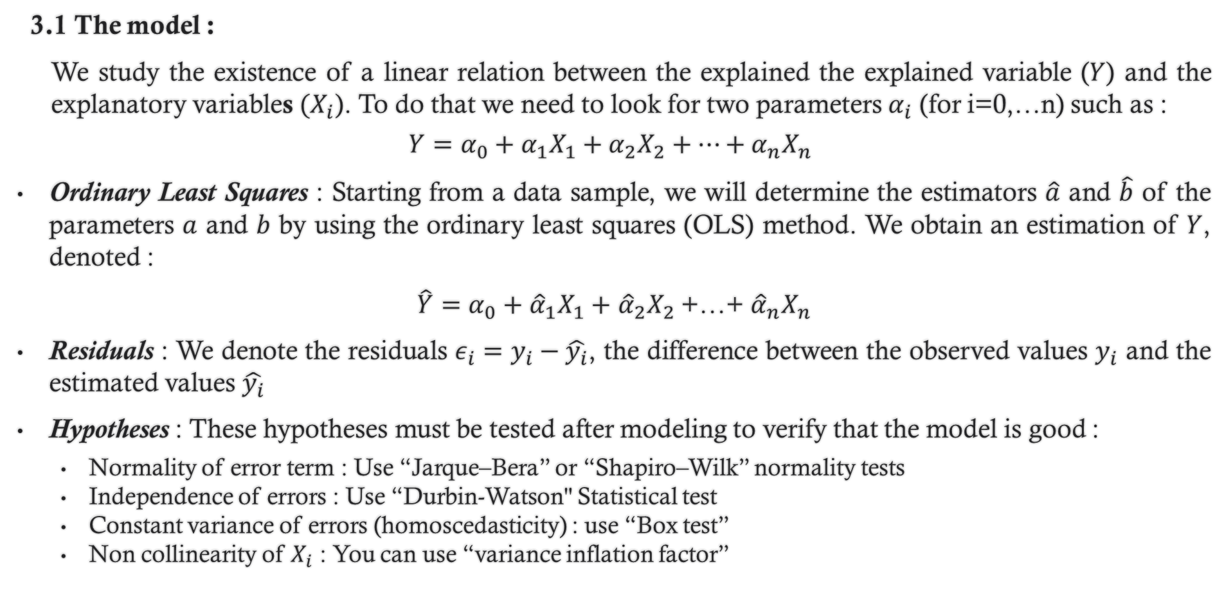
3. Multiple linear regression
3.1 The model :
We study the existence of a linear relation between the explained the explained variable ($Y$) and the explanatory variables $(X_{i}$). To do that we need to look for two parameters $α_{i}$ (for i=0,…n) such as :
$$Y=α_{0}+α_{1}X_{1}+α_{2}X_{2}+…+α_{n}X_{n}$$
Ordinary Least Squares : Starting from a data sample, we will determine the estimators $\hat{a}$ and $\hat{b}$ of the parameters $a$ and $b$ by using the ordinary least squares (OLS) method. We obtain an estimation of $Y$, denoted :
$\hat{Y}=α_{0}+{\hat{α}}_{1}X_{1}+$ ${\hat{α}}_{2}X_{2}$+…+ ${\hat{α}}_{n}X_{n}$
Residuals : We denote the residuals $ε_{i}=y_{i}−\hat{y_{i}}$, the difference between the observed values $y_{i}$ and the estimated values $\hat{y_{i}}$
Hypotheses : These hypotheses must be tested after modeling to verify that the model is good :
Normality of error term : Use “Jarque–Bera” or “Shapiro–Wilk” normality tests
Independence of errors : Use “Durbin-Watson" Statistical test
Constant variance of errors (homoscedasticity) : use “Box test”
Non collinearity of $X_{i}$ : You can use “variance inflation factor”

